Slide 1
Retail, Hospitality, and Tourism
LA REGIONAL PROGRAM ADVISORY
NOVEMBER 1, 2023
11:00 AM – 1:00 PM

Slide 2
THANK YOU TO OUR INDUSTRY PARTNERS!

Slide 3
Retail, Hospitality, and Tourism
REGIONAL PROGRAM ADVISORY
Jermaine Hampton Vice President of Workforce Development and Special Projects LAEDC
Jose Pelayo
Program Manager, Workforce Development LAEDC
Alicia Nyein
Asst. Program Manager, Workforce Development
LAEDC
Jared Lopez
Asst. Program Manager, Workforce Development
LAEDC

Slide 4
Retail, Hospitality, and Tourism
REGIONAL PROGRAM ADVISORY
The LA-19 is leading industry-education partnerships to collaboratively strengthen our region’s talent development ecosystem
Data-driven research on the supply and demand for talent
Industry Councils and Regional Program Advisories
Developing work-based learning and employment opportunities
For more information, visit: https://losangelesrc.org
Notes:
Today’s regional program advisory is in collaboration with the Los Angeles Regional Consortium as well as the Center of Excellence for Labor Market Research, LAEDC and our industry partners.
Our presentation will start with our research and data from IAE as well as Center of Excellence then end with our roundtable discussions with our industry partners.

Slide 5
Retail, Hospitality, and Tourism
REGIONAL PROGRAM ADVISORY
Dr. Narineh Makijan Chair/Assistant Vice President
Los Angeles Regional Consortium

Slide 6
Retail, Hospitality, and Tourism
REGIONAL PROGRAM ADVISORY
Diego Saavedra Research Analyst,
Institute for Applied Economics
LAEDC
Notes:
Next up we have Diego who will give us an overview of the current landscape in the retail, hospitality, and tourism industry and what is looks like.

Slide 7
Current Landscape
Retail, Hospitality, and Tourism
REGIONAL PROGRAM ADVISORY
For Retail, Hospitality, and Tourism industries, industrial employment is measured using 8 NAICS codes
Scheduled Passenger Air Transportation
Deep Sea Passenger Transportation
Scenic and Sightseeing Transportation
Travel Arrangement and Reservation Services
Convention and Trade Show Organizers
Gambling Industries
Traveler Accommodation
Food Services and Drinking Places

Slide 8
Current Landscape
Retail, Hospitality, and Tourism
REGIONAL PROGRAM ADVISORY
Hospitality industries have employed nearly half a million people for the last 6 years. Employment was slowly rising year over year but suffered a setback in 2020. Since then, employment continued its previous upward trend heading into 2023.

Slide 9
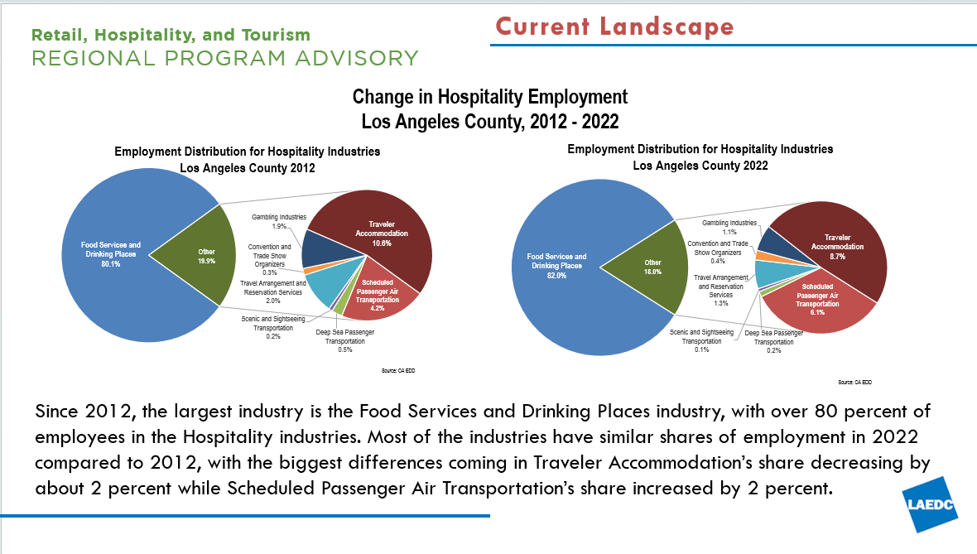
Retail, Hospitality, and Tourism
REGIONAL PROGRAM ADVISORY
Change in Hospitality Employment
Los Angeles County, 2012 - 2022
Since 2012, the largest industry is the Food Services and Drinking Places industry, with over 80 percent of employees in the Hospitality industries. Most of the industries have similar shares of employment in 2022 compared to 2012, with the biggest differences coming in Traveler Accommodation’s share decreasing by about 2 percent while Scheduled Passenger Air Transportation’s share increased by 2 percent.

Slide 10
Current Landscape
Retail, Hospitality, and Tourism
REGIONAL PROGRAM ADVISORY
Average Annual Pay in Hospitality Industries
Most industries pay a living wage in Los Angeles County, with 6 out of 8 paying over $50,000 per year on average.
The highest paying industry on average is Deep Sea Passenger Transportation, with an average of $130,704 per year, and on average all Hospitality industries pay $73,963.
In 2022, the average salary in Los Angeles County was about $83,971 per year.
Notes:
Mention the 2 lowest in presentation!!!!

Slide 11
Current Landscape
Retail, Hospitality, and Tourism
REGIONAL PROGRAM ADVISORY
Real Wage Growth in Hospitality Industries
Over the last 10 years, real wages grew at varying rates across the industry groupings.
The largest increase occurred in the Deep Sea Passenger Transportation industry, with 46 percent growth since 2012.
Overall, real wages in the Hospitality industries grew over 26 percent.

Slide 12
Looking Forward
Retail, Hospitality, and Tourism
REGIONAL PROGRAM ADVISORY
From 2022 to 2028, employment is expected to grow 15.8 percent, forecasting over 14,500 new jobs per year in Hospitality industries.

Slide 13
Looking Forward
Retail, Hospitality, and Tourism
REGIONAL PROGRAM ADVISORY
Hospitality is anticipated to grow the most in the Convention and Trade Show Organizers industry (26 percent).
Overall, Hospitality industries are expected to grow nearly 16 percent through 2028.

Slide 14
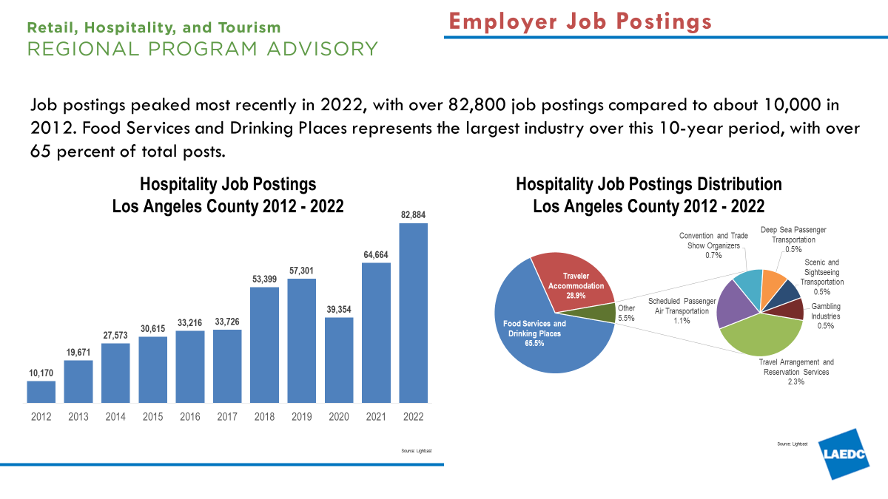
Employer Job Postings
Retail, Hospitality, and Tourism
REGIONAL PROGRAM ADVISORY
Job postings peaked most recently in 2022, with over 82,800 job postings compared to about 10,000 in 2012. Food Services and Drinking Places represents the largest industry over this 10-year period, with over 65 percent of total posts.

Slide 15
Employer Job Postings
Retail, Hospitality, and Tourism
REGIONAL PROGRAM ADVISORY
Since 2012, Food Services and Drinking Places continue to have the most posts through 2022, followed by Traveler Accommodation.

Slide 16
Employer Job Postings
Retail, Hospitality, and Tourism
REGIONAL PROGRAM ADVISORY
Marriott International
Jack in the Box
Major Hospitality Employers in Los Angeles County, 2022
Hilton
Starbucks
Sodexo

Slide 17
Industry Demographics
Retail, Hospitality, and Tourism
REGIONAL PROGRAM ADVISORY
Over 35 percent of employees in Hospitality industries are between 25 and 39 years old, about 12 percent more than in other industries in Los Angeles County. Overall, Hospitality workers are younger than in other industries, with about 64 percent of workers under 40 compared to about 54 percent in other industries.

Slide 18
Industry Demographics
Retail, Hospitality, and Tourism
REGIONAL PROGRAM ADVISORY
About 39 percent of employees in Hospitality industries have an Associates/some college certificate, over 10 percent more than in other industries in Los Angeles County.
Notes:
Compared to other industries, Hospitality jobs have a higher proportion of employees with some college experience or a bachelor’s degree, accounting for almost 65 percent of employees compared to about 47 percent in all other industries.

Slide 19
Industry Demographics
Retail, Hospitality, and Tourism
REGIONAL PROGRAM ADVISORY
Black workers are underrepresented, with only about 5 percent of workers compared to nearly 8 percent in all other industries. Hispanic/Latino workers are well represented in Hospitality industries, with about 10 percent more workers compared to other industries in Los Angeles County.

Slide 20
Industry Demographics
Retail, Hospitality, and Tourism
REGIONAL PROGRAM ADVISORY
The gender distribution in Hospitality industries is nearly identical, with there being a marginal 1.2 percent more male workers than female workers.

Slide 21
Occupations Demographics
Retail, Hospitality, and Tourism
REGIONAL PROGRAM ADVISORY
Metric |  | Food Service Managers | Flight Attendants | Reservation & Transportation Ticket Agents & Travel Clerks | Chefs & Head Cooks | Merchandise Displayers & Window Trimmers
Sex | Male | 54.0% | 22.9% | 51.3% | 77.4% | 35.7%
 | Female | 46.0% | 77.1% | 48.7% | 22.6% | 64.3%
Education | Less than HS | 7.0% | 0.7% | 4.2% | 13.5% | 2.9%
 | High School | 24.9% | 11.4% | 25.8% | 30.6% | 14.2%
 | Some College/Associates | 37.7% | 43.2% | 43.8% | 37.0% | 36.5%
 | Bachelor's | 24.0% | 41.3% | 23.5% | 14.4% | 40.2%
 | Graduate School | 6.5% | 3.4% | 2.7% | 4.5% | 6.2%
Age | <25 | 11.9% | 0.5% | 12.9% | 6.7% | 15.4%
 | 25-39 | 40.5% | 41.4% | 38.0% | 39.5% | 42.6%
 | 40-54 | 26.6% | 29.1% | 29.9% | 31.8% | 19.1%
 | >54 | 20.9% | 29.1% | 19.2% | 21.9% | 22.9%
Race | Hispanic | 46.6% | 26.4% | 47.1% | 48.5% | 36.1%
 | White | 24.8% | 39.4% | 21.9% | 13.9% | 23.2%
 | Asian | 21.8% | 21.5% | 16.8% | 29.4% | 21.1%
 | Black | 3.5% | 9.2% | 11.4% | 6.4% | 1.7%
Source: PUMS
These occupations are accessible to workers with some college/AA degree or a Bachelor’s degree, with about 54 to 81 percent of workers in these occupations with similar levels of education or less. Female workers are underrepresented in Chef and Head Cook jobs, with about 28 percent less female workers compared to other industries in LA County.
Notes:
Under: Black in Food Manager and Merch Display. Latino in Flight and Merch. Male in Flight and Merch. Female in Chef and Head Cook
Hispanic/Latino and Black workers are underrepresented in Merchandise Displayer and Window Trimmer jobs, with about 13 to 6 percent less Hispanic/Latino and Black workers respectively than the average for other industries in Los Angeles County.

Slide 22
Key Takeaways
Retail, Hospitality, and Tourism
REGIONAL PROGRAM ADVISORY
Real wages have grown over 26 percent since 2012
5 out of 8 industries studied pay a living wage in Los Angeles county on average.
Convention and Trade Show Organizing industry is expected to grow the most through 2028, with growth over 26 percent
Employment is expected to grow nearly 16 percent on average across all Hospitality industries through 2028.

Slide 23
Retail, Hospitality, and Tourism
REGIONAL PROGRAM ADVISORY
CONTACT INFORMATION
Diego Saavedra
diego.saavedra@laedc.org

Slide 24
Retail, Hospitality, and Tourism
REGIONAL PROGRAM ADVISORY
Jermaine Hampton Vice President of Workforce Development and Special Projects LAEDC

Slide 25
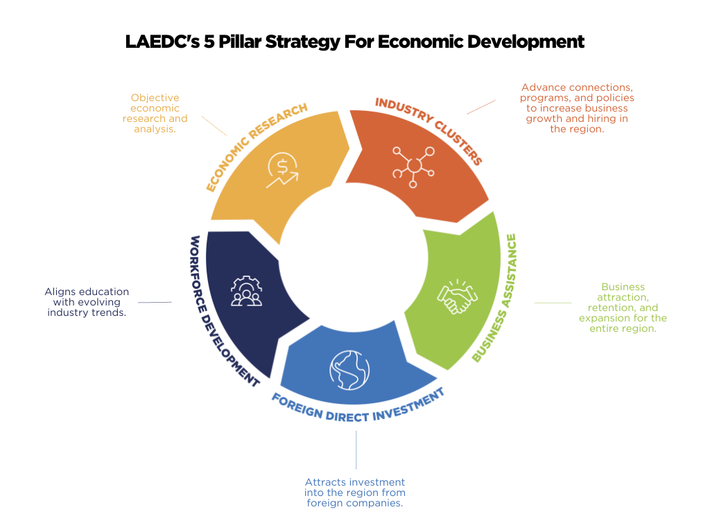

Slide 26
Retail, Hospitality, and Tourism
REGIONAL PROGRAM ADVISORY
Luke Meyer Director
LA Center of Excellence for Labor Market Research hosted at Mt. San Antonio College
Notes:
Welcome everyone
Thanks to LAEDC for contributions and partnership with CCW
And huge thanks to our 19 LA and – they are the ones who get our students in the door, teach them the knowledge & skills, and help them land jobs
The Centers of Excellence (COE) for Labor Market Research deliver regional workforce research and technical expertise to California Community Colleges for program decision-making and resource development.

Slide 27
Community College Talent Supply
Retail, Hospitality, and Tourism
REGIONAL PROGRAM ADVISORY
Hospitality programs are offered at 17/19 of the community colleges in LA, focused on:
Lodging Management
Resort/Club Management
Restaurant Management
Culinary Arts
Travel Services and Tourism
Flight Attendant
Fashion & Interior Design

Slide 28
RHT Student Completions
Retail, Hospitality, and Tourism
REGIONAL PROGRAM ADVISORY
Between 2011 and 2017, student completions in the Retail, Hospitality and Tourism (RHT) sector steadily increased, peaking at 750 awards in the 2016-17 academic year.
Source: Cal-PASS Plus LaunchBoard
Notes:
Between 2011 and 2017, student completions in the Retail, Hospitality and Tourism (RHT) sector steadily increased, peaking at 750 awards in the 2016-17 academic year. Since then, the number of students earning awards has declined by 22%, to 584 RHT students earning awards in 2021-22. However, there are more students who earned a degree or certificate in 2021-22 (584 students) than ten years ago (468 students).

Slide 29
RHT Student Enrollments
Retail, Hospitality, and Tourism
REGIONAL PROGRAM ADVISORY
Student enrollments in RHT pathways over the past ten years have declined by nearly 34%, from 12,529 students in 2011-12 to 8,310 students in 2021-22. Despite this decline, the portion of RHT students earning a degree or certificate has risen from approximately 4% in 2011-12 to 7% in 2021-22.
Source: Cal-PASS Plus LaunchBoard
Notes:
In the 2021-22 academic year, there were 8,310 students enrolled in RHT pathways at 17 of the 19 community colleges in the Los Angeles region. Student enrollments in RHT pathways over the past ten years have declined by nearly 34%, from 12,529 students in 2011-12 to 8,310 students in 2021-22. Despite this decline, the portion of RHT students earning a degree or certificate has risen from approximately 4% in 2011-12 to 7% in 2121-22.

Slide 30
RHT Enrollments by College
Retail, Hospitality, and Tourism
REGIONAL PROGRAM ADVISORY
Looking more closely at the 8,772 student enrollments from the 2020-21 academic year, this exhibit displays the number of students taking courses in RHT pathways by college with Mt. San Antonio, LA-Trade Tech, and Santa Monica each enrolling more than 1,000 students.
Source: Cal-PASS Plus LaunchBoard
Notes:
Looking more closely at the 8,772 student enrollments from the 2020-21 academic year, the exhibit below displays the number of students taking courses in RHT pathways by college, with Mt. San Antonio, LA-Trade Tech, and Santa Monica each enrolling more than 1,000 students.

Slide 31
RHT Student Demographics
Retail, Hospitality, and Tourism
REGIONAL PROGRAM ADVISORY
Nearly two-thirds of RHT students at the LA community colleges are female, half identify as Hispanic, and half are 24-years-old or younger.
Source: Cal-PASS Plus LaunchBoard
Notes:
Nearly two-thirds of RHT students at the LA community colleges are female, half identify as Hispanic, and half are 24-years-old or younger. This young group of ethnically-diverse RHT students represents the new female-forward workforce entering LA’s retail, hospitality and tourism industries. The exhibits below display LA RHT student demographics from the 2020-21 academic year, based on the 8,772 students enrolled that year.
*For ethnicity, the “other” category includes Asian American/Alaska Native, Pacific Islander or Hawaiian Native and Multiple Values Reported.

Slide 32
Retail, Hospitality, and Tourism
REGIONAL PROGRAM ADVISORY
RHT Programs At-a-Glance
TOP6 - Program Title | 2019-20 | 2020-21 | 2021-22 | Latest 3 Yr Avg
050600 - Business Management | 832 | 721 | 635 | 729
130630 - Culinary Arts | 390 | 302 | 426 | 373
050650 - Retail Store Operations and Mgmt. | 217 | 211 | 217 | 215
050630 - Mgmt. Development and Supervision | 116 | 143 | 172 | 144
130310 - Fashion Design | 152 | 102 | 103 | 119
130700 - Hospitality | 87 | 97 | 98 | 94
130200 - Interior Design and Merchandising | 80 | 76 | 93 | 83
130320 - Fashion Merchandising | 91 | 87 | 65 | 81
130710 - Restaurant and Food Services and Mgmt. | 65 | 32 | 46 | 48
130620 - Dietetic Services and Management | 28 | 28 | 52 | 36
130720 - Lodging Management | - | 21 | 71 | 31
050940 - Sales and Salesmanship | 19 | 34 | 28 | 27
130300 - Fashion | 23 | 24 | 33 | 27
051800 - Customer Service | 23 | 28 | 20 | 24
051600 - Labor and Industrial Relations | 9 | 12 | 11 | 11
302040 - Flight Attendant | 8 | 7 | 10 | 8
011510 - Parks and Outdoor Recreation | 3 | 5 | 6 | 5
130110 - Consumer Services | - | 2 | 8 | 3
051440 - Office Management | 1 | 2 | 4 | 2
060600 - Public Relations | 2 | 1 | 1 | 1
130100 - Family and Consumer Sciences, General | - | - | 1 | 0
Total | 2,146 | 1,935 | 2,100 | 2,060
Notes:
To demonstrate the size and breadth of retail, hospitality and tourism programs offered by LA’s community colleges, the table below displays the number of awards issued (certificates and degrees) from LA’s RHT programs over the most recent three academic years. Business Management has issued the greatest number of awards, averaging 729 during the last three years. There was a decline in RHT program awards between 2019-20 to 2020-21 (-10%), most likely due to the COVID-19 pandemic and widespread shutdown within the RHT industry. However, RHT program awards rebounded with a 9% increase in 2021-22.
Source: California Community Colleges Chancellor’s Office MIS Data Mart

Slide 33
RHT Student Employment Outcomes
Retail, Hospitality, and Tourism
REGIONAL PROGRAM ADVISORY
Source: Cal-PASS Plus LaunchBoard
Notes:
According to LaunchBoard data, an average of two-thirds of exiting students from LA’s RHT programs reported working in a job closely related to their field of study between 2013 and 2019. Compared with all CTE exiting students, LA RHT students are working in a job closely related to their field of study at similar rates.

Slide 34
RHT Student Employment Outcomes
Retail, Hospitality, and Tourism
REGIONAL PROGRAM ADVISORY
Source: Cal-PASS Plus LaunchBoard
Notes:
RHT students increased their annual earnings between 14% and 24% over the past five years of data collection (2015-2020). However, this median change in earnings is less for each academic year when compared to all exiting CTE students. For instance, while RHT students increased their earnings by 14% in 2020, all CTE students increased their earnings by 21% - a 7% difference.

Slide 35
RHT Student Employment Outcomes
Retail, Hospitality, and Tourism
REGIONAL PROGRAM ADVISORY
Source: Cal-PASS Plus LaunchBoard
Notes:
Median annual earnings for exiting RHT students have increased over the past decade, with students earning $27,612 in 2019-20. Median annual earnings for all CTE students in 2019-20 was $34,812, a $7,200 difference in annual salaries compared to RHT exiting students. However, these median annual earnings for both RHT and all CTE students are still less than the living wage in Los Angeles County ($38,217).

Slide 36
RHT Student Employment Outcomes
Retail, Hospitality, and Tourism
REGIONAL PROGRAM ADVISORY
Source: Cal-PASS Plus LaunchBoard
Notes:
The same can be said for exiting students who attained a living wage. Since 2011, RHT students are less likely to earn a living wage than all CTE students, with approximately one-third of exiting RHT students earning a living wage. On average, 40% of all CTE students earned a living wage after exiting between 2011 and 2020. There are several potential explanations for these lower-then-average earnings; from the likelihood that most exiting students are working in entry-level positions, to the way the data are collected, to the fact that that the RHT industry employs a large share of gig workers compared to other prominent industries in county. Regardless of the reason, the rising rate of inflation coupled with increasing living costs places a premium on our students landing jobs that pay above a living wage to adequately support themselves and in many cases, their families.

Slide 37
Target RHT Occupations
Retail, Hospitality, and Tourism
REGIONAL PROGRAM ADVISORY
Source: Lightcast, datarun 2023.3
Occupation | 2022 Jobs | 2027 Jobs | 2022 - 2027 % Change | Avg. Annual Openings | Entry-Level Hourly Earnings (25th Percentile) | Median Hourly Earnings | Experienced Hourly Earnings (75th Percentile)
Food Service Managers | 12,815 | 13,789 | 8% | 1,865 | $19.14 | $27.53 | $36.29
Flight Attendants | 8,692 | 9,974 | 15% | 1,518 | $26.07 | $32.95 | $39.94
Reservation and Transportation Ticket Agents and Travel Clerks | 7,145 | 7,412 | 4% | 922 | $17.64 | $18.22 | $23.06
Chefs and Head Cooks | 5,781 | 6,519 | 13% | 967 | $22.37 | $30.54 | $39.73
Merchandise Displayers and Window Trimmers | 5,684 | 5,932 | 4% | 731 | $17.51 | $19.12 | $22.18
Interior Designers | 4,718 | 5,071 | 7% | 491 | $25.12 | $34.38 | $46.08
Fashion Designers | 4,524 | 4,296 | (5%) | 439 | $29.10 | $38.33 | $52.34
Meeting, Convention, and Event Planners | 4,411 | 4,954 | 12% | 589 | $22.16 | $29.41 | $39.72
Travel Agents | 2,149 | 1,775 | (17%) | 253 | $20.37 | $24.57 | $31.12
Tour and Travel Guides | 1,889 | 1,887 | (0%) | 367 | $16.85 | $17.91 | $22.20
Lodging Managers | 1,214 | 1,302 | 7% | 167 | $19.73 | $28.55 | $43.54
Gambling Managers | 116 | 115 | (1%) | 13 | $44.41 | $49.51 | $66.91
LA County Self-Sufficiency Standard Wage: $18.10/hour

Slide 38
Employer Job Postings
Retail, Hospitality, and Tourism
REGIONAL PROGRAM ADVISORY
24,354 online job postings
Oct 2022 – Sep 2023
Source: Lightcast Job Postings, datarun 2023.3
Notes:
Over the past 12 months (Oct 2022 through Sept 2023), there were 24,354 online job postings for the 12 occupations of interest. The majority of job postings (47%) were for food service managers, followed by merchandise displayers and window trimmers (19%), and chefs and head cooks (12%).

Slide 39
Employer Job Postings
Retail, Hospitality, and Tourism
REGIONAL PROGRAM ADVISORY
Job Title | Job Ads | Employer | Job Ads
General Managers | 1,486 | Domino's Pizza | 654
Assistant Managers | 1,272 | Pizza Hut | 411
Restaurant Managers | 844 | Taco Bell | 332
Assistant General Managers | 764 | Restaurant Depot | 328
Retail Merchandisers | 654 | Marriott International | 266
Sous Chefs | 591 | Compass Group | 259
Merchandisers | 588 | Hilton | 235
Shift Managers | 520 | Buffalo Wild Wings | 181
Assistant Restaurant Managers | 426 | McDonald's | 181
Restaurant General Managers | 426 | The Coca-Cola Company | 154
Source: Lightcast Job Postings, datarun 2023.3
Notes:
The highest number of job postings by job title were for general managers, assistant managers, restaurant managers, assistant general managers, and retail merchandisers. The top employers, by number of job postings, in Los Angeles County were Domino’s Pizza, Pizza Hut, and Taco Bell. The top skills desired by employers for potential job candidates were restaurant operating, merchandising, food safety and sanitation, marketing, restaurant management, food services, purchasing, customer complaint resolution, auditing, cooking, and food quality assurance and control.

Slide 40
Employer Job Postings
Retail, Hospitality, and Tourism
REGIONAL PROGRAM ADVISORY
Source: Lightcast Job Postings, datarun 2023.3
Notes:
Since October 2022, advertised wages from job postings for these 12 retail, hospitality and tourism occupations have risen by 23%. August and September 2023 has had the highest advertised wages over the past 12 months, with job postings averaging an annual salary of more than $60,000. Of the job postings that listed minimum experience criteria, the majority (50%) were for positions asking for 2-3 years of work experience. Only 38% of job postings listed a minimum education requirement for these retail, hospitality and tourism occupations; of these job postings, 55% listed a high school diploma or GED, 10% listed an associate degree, and 35% listed a bachelor’s degree.
Within Los Angeles County, the top cities for these retail, hospitality and tourism job postings were Los Angeles, Long Beach, Santa Monica, Pasadena, and Torrance. These cities align with Los Angeles County’s most populous cities, as well as the locations of large hospitality and tourism hubs in the region. The city of Los Angeles accounted for 43% of job postings.

Slide 41
Retail, Hospitality, and Tourism
REGIONAL PROGRAM ADVISORY
CONTACT INFORMATION
LUKE MEYER
(909) 274-6106
lmeyer7@mtsac.edu
Notes:
For those interested in continuing this conversation, or if you have any questions about the data I presented, please reach out.

Slide 42
Retail, Hospitality, and Tourism
REGIONAL PROGRAM ADVISORY
ROUNDTABLE DISCUSSION
Mute yourself throughout discussion
Submit questions through the chat box
15-20 minutes of discussion per topic
Discussion will be followed by Q&A

Slide 43
Retail, Hospitality, and Tourism
REGIONAL PROGRAM ADVISORY
Sarah D’Angelo Director of Talent Acquisition and University Recruitment
Marriott International
Email: Sarah.Dangelo@marriott.com

Slide 44
Retail, Hospitality, and Tourism
REGIONAL PROGRAM ADVISORY
Jeffrey Forrest
Director of Older Youth Initiatives
Conrad N. Hilton Foundation
Email: Jeffrey.F@hiltonfoundation.org

Slide 45
Retail, Hospitality, and Tourism
REGIONAL PROGRAM ADVISORY
Cathy Diaz
Human Resources Manager
AEG- Crypto.com Arena, Peacock Theater & L.A. LIVE
Email: CDiaz@aegworldwide.com

Slide 46
Retail, Hospitality, and Tourism
REGIONAL PROGRAM ADVISORY
Gregory L. Deshields
Executive Director
Tourism Diversity Matters

Slide 47
Retail, Hospitality, and Tourism
REGIONAL PROGRAM ADVISORY
Yvonne E. Drayton
Director of Operations
Tourism Diversity Matters
Email: ydrayton@tourismdiversitymatters.org

Slide 48
Retail, Hospitality, and Tourism
REGIONAL PROGRAM ADVISORY
Lilly Rocha
Executive Director and CEO
Latino Restaurant Association
Email: lilly@latinorestaurantassociation.org

Slide 49
Retail, Hospitality, and Tourism
REGIONAL PROGRAM ADVISORY
FEEDBACK POLL
AND NEXT STEPS

Slide 50
Retail, Hospitality, and Tourism
REGIONAL PROGRAM ADVISORY
THANK YOU!
https://losangelesrc.org/
For more information contact:
Jermaine Hampton: jermaine.hampton@laedc.org
Jose Pelayo: jose.pelayo@laedc.org
Jared Lopez: jared.lopez@laedc.org
Alicia Nyein: alicia.nyein@laedc.org

