Slide 1
PLANNING A MODERN APPRENTICESHIP
WHAT YOU NEED TO KNOW… THAT YOU DIDN’T KNOW YOU NEEDED TO KNOW

Slide 2
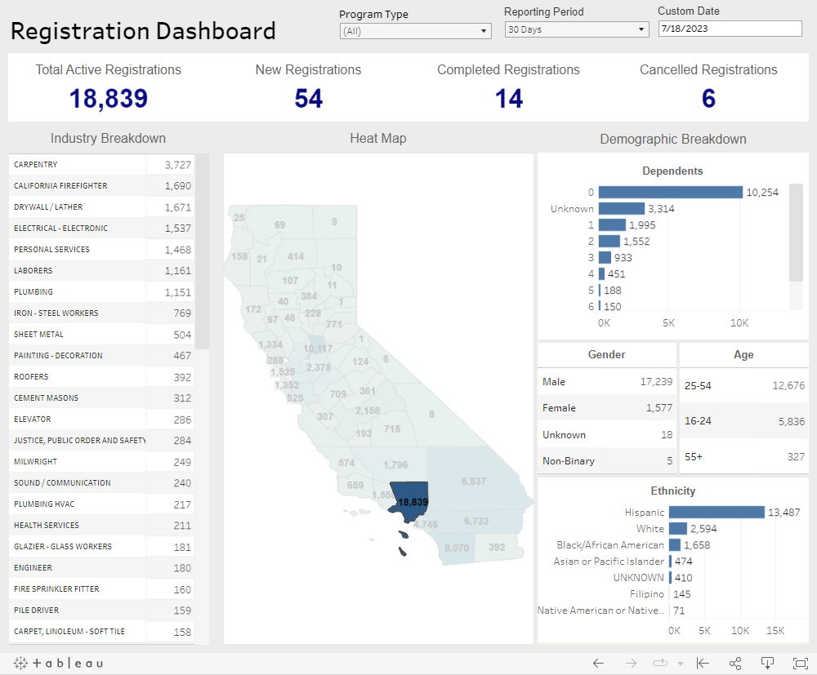
Apprenticeship Matters to LA County Residents:
Approximately 19,000 Registered Apprentices call LA home
20% of California’s apprentices
Apprenticeships = Jobs
Apprentices make
$300k+ over career
Zero educational debt
Businesses more competitive
Big LEAs (Rio Hondo, Cerritos, LAUSD, LA COE, Hacienda la Puente USD)

Slide 3
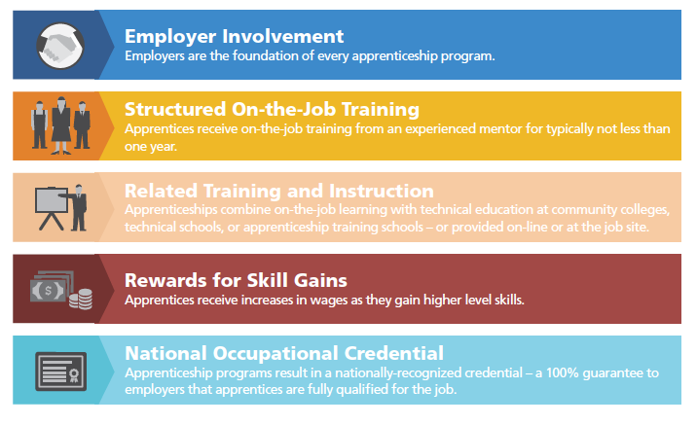
APPRENTICESHIP THE GOLD STANDARD

Slide 4
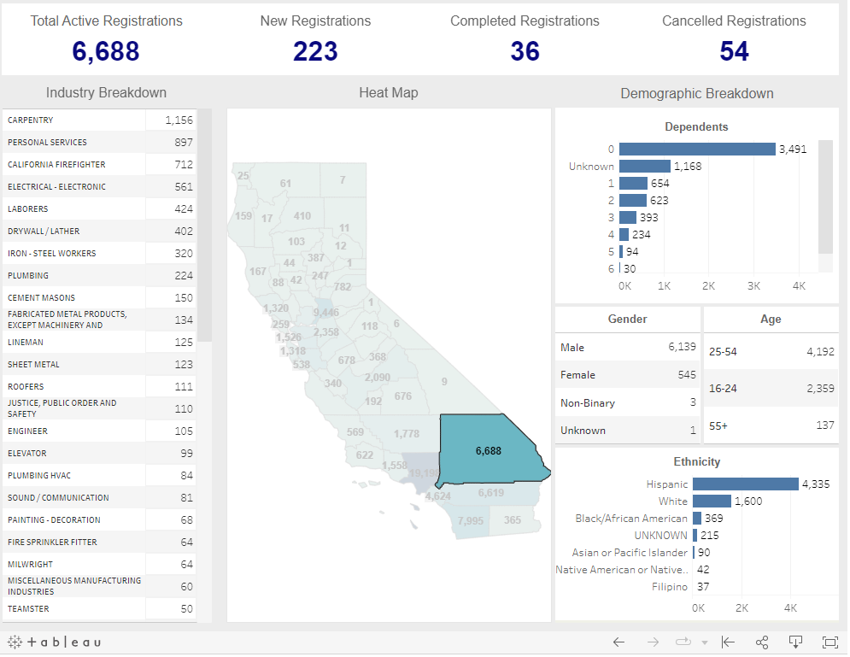
Some Painful Realities…
LA County BY THE NUMBERS
Only 11% of apprenticeship opportunities exist outside of building & fire trades occupations
Only 8% of apprentices are women (1/2 in lower paying fields)
The average starting age of an apprentice is approximately 30 years old
(Note: Over 2/3s of the 400,000 high school graduates in California were identified as socioeconomically disadvantaged, and almost 80% in LA County do not attain a bachelor’s degree)
Majority of LA registered apprentices do not receive higher-education credit locally for their apprenticeship despite completing hundreds of hours annually of high-level education and training

Slide 5
Blacks and African Americans are more likely than all other racial groups combined to make less than the minimum wage upon completion of the apprenticeship program. One-quarter of black or African American apprentices exit these programs making less than the federal minimum wage. A previous analysis examining the median exit wage for incarcerated apprentices found that from 2008 to 2016, this group made just 35 cents per hour.
Zessoules, Daniella and Olugbenga Ajilore. “Wage Gaps and Outcomes in Apprenticeship Programs: The Effects of Gender, Race and Region.” Center for American Progress.

Slide 6
The Takeaway…
The incarceration of blacks and African Americans and occupational segregation along racial and gender lines require more research in order to make Registered Apprenticeship programs accessible—empowering them to honor their mission to “provide affordable paths to good jobs and, ultimately, careers.”
Zessoules, Daniella and Olugbenga Ajilore. “Wage Gaps and Outcomes in Apprenticeship Programs: The Effects of Gender, Race and Region.” Center for American Progress.

Slide 7
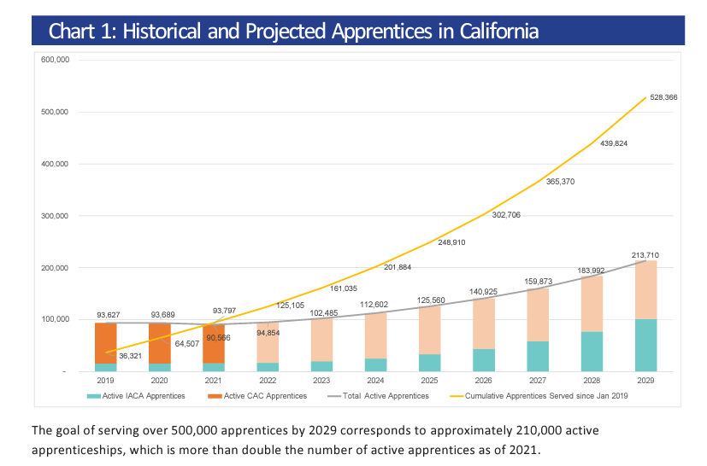
The Road to 500,000

Slide 8
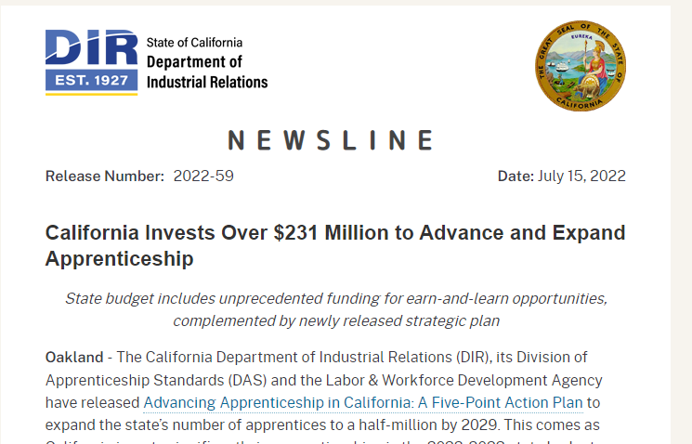
The Funding…

Slide 9
All these Funding Mechanisms…
Strong Workforce Program
California Apprenticeship Initiative
Department of Labor
Philanthropy & Foundation Funding
National Science Foundation
High Roads Training Partnerships
Full-Time Equivalent Student (FTES) Apportionment
Related Supplemental Instruction (RSI) Funding
Employment Training Panel
Workforce Investment Opportunity Act (WIOA)
Apprenticeship Innovation Funding (AIF)
National Center for Academic Excellence

Slide 10
…Make it as easy as….
Getting large public institutions to agree about complicated end goals, processes, and timelines
Becoming a “certified ninja” in WIOA, community college education code, apprenticeship codes, and sector nuances, policies and politics
Completing complicated technical contracts and reports to multiple government entities that use different terms and metrics to determine success

Slide 11
Stuck on the BASICS

Slide 12
PROGRAMS WITH NO SYSTEM
Building trades programs - as well as Fire Trades - share the same “root system”
Programs develop from within the system and they are sustained by the system
Items to Address:
Standards Practices and Shared Understanding
Agreement about Levels & Quality
New and Innovative programs have different “root systems” (CAI Grants, CTE, CBOs, DOL, etc.)
Permits variety but lacks stainability and long-term impact

Slide 13
CALIFORNIA’S LEADING MODEL
Public Works-Based Construction Apprenticeship
Estimated $6 Million in Training Funds for each $1 Billion in public works construction (Labor Code 1777.7(d))
CA Spends hundreds of millions to train construction apprentices.
The funding goes through a limited number of authorized “accredited” training committees and covers the cost of running the apprenticeship program.
Limits on the number of authorized training committees focuses the funding into a small number of committees (CCR 212.2 & AB 235)
Quality is regulated and outcomes established through Public Funding (DLSE)
Apprentices are paid an increasing rate by law and contractors registered with the state report and certify the wages (violations punishable by fine and imprisonment)
Companies are incentivized to train registered apprentices:
Requirement of Public Works law (Labor Code 1777.5)
Prevailing Wage laws provide financial incentives for contractors to use registered system
i.e. Carpenter Apprentice saves $108k (statewide we’ve set up a $500 million incentive plan)
Education Providers receive revenue based on enrollment in instruction:
RSI Funding
Employment Training Panel
DOWNSIDES:
Average age of apprentice is high and benefits to apprentices increase if they start earlier
Access and equity in traditional system is problematic
Consistent User Experience
Consistent Outcomes

Slide 14
The Big IDEA
First, we will develop transformation maps for every cluster, industry and region of our state to make sure we’re preparing folks for the jobs that actually exist. Working with UC, CSU and most substantively the community colleges, we will overlay industry trends, job availability, and educational data, and then develop relevant curriculum to meet those workforce and skills needs. We’ll also nurture regional and cluster-based collaborations partnering industry, our academic institutions and communities to innovate new ideas and spur economic growth throughout the state.
Second, we will establish 500,000 earn-and-learn apprenticeships by 2029, creating a new vocational pipeline of high-skill workers. In an increasingly global world, apprenticeships provide the education and training necessary to prepare Californians for the jobs of today and tomorrow.

Slide 15
The NEW Root System
First, we will develop transformation maps for every cluster, industry and region of our state to make sure we’re preparing folks for the jobs that actually exist. Working with UC, CSU and most substantively the community colleges, we will overlay industry trends, job availability, and educational data, and then develop relevant curriculum to meet those workforce and skills needs. We’ll also nurture regional and cluster-based collaborations partnering industry, our academic institutions and communities to innovate new ideas and spur economic growth throughout the state.
Second, we will establish 500,000 earn-and-learn apprenticeships by 2029, creating a new vocational pipeline of high-skill workers. In an increasingly global world, apprenticeships provide the education and training necessary to prepare Californians for the jobs of today and tomorrow.

Slide 16
The Big IDEA
Third, we will provide skills accounts for any Californian looking for work, no matter what stage of life. In today’s rapidly changing economy, our workforce must be able to adapt to new needs and advancements. These accounts, established with the backing of business, labor, and government, will allow Californians to tap into the vast resources of our community college system to help get folks back on their feet.

Slide 17
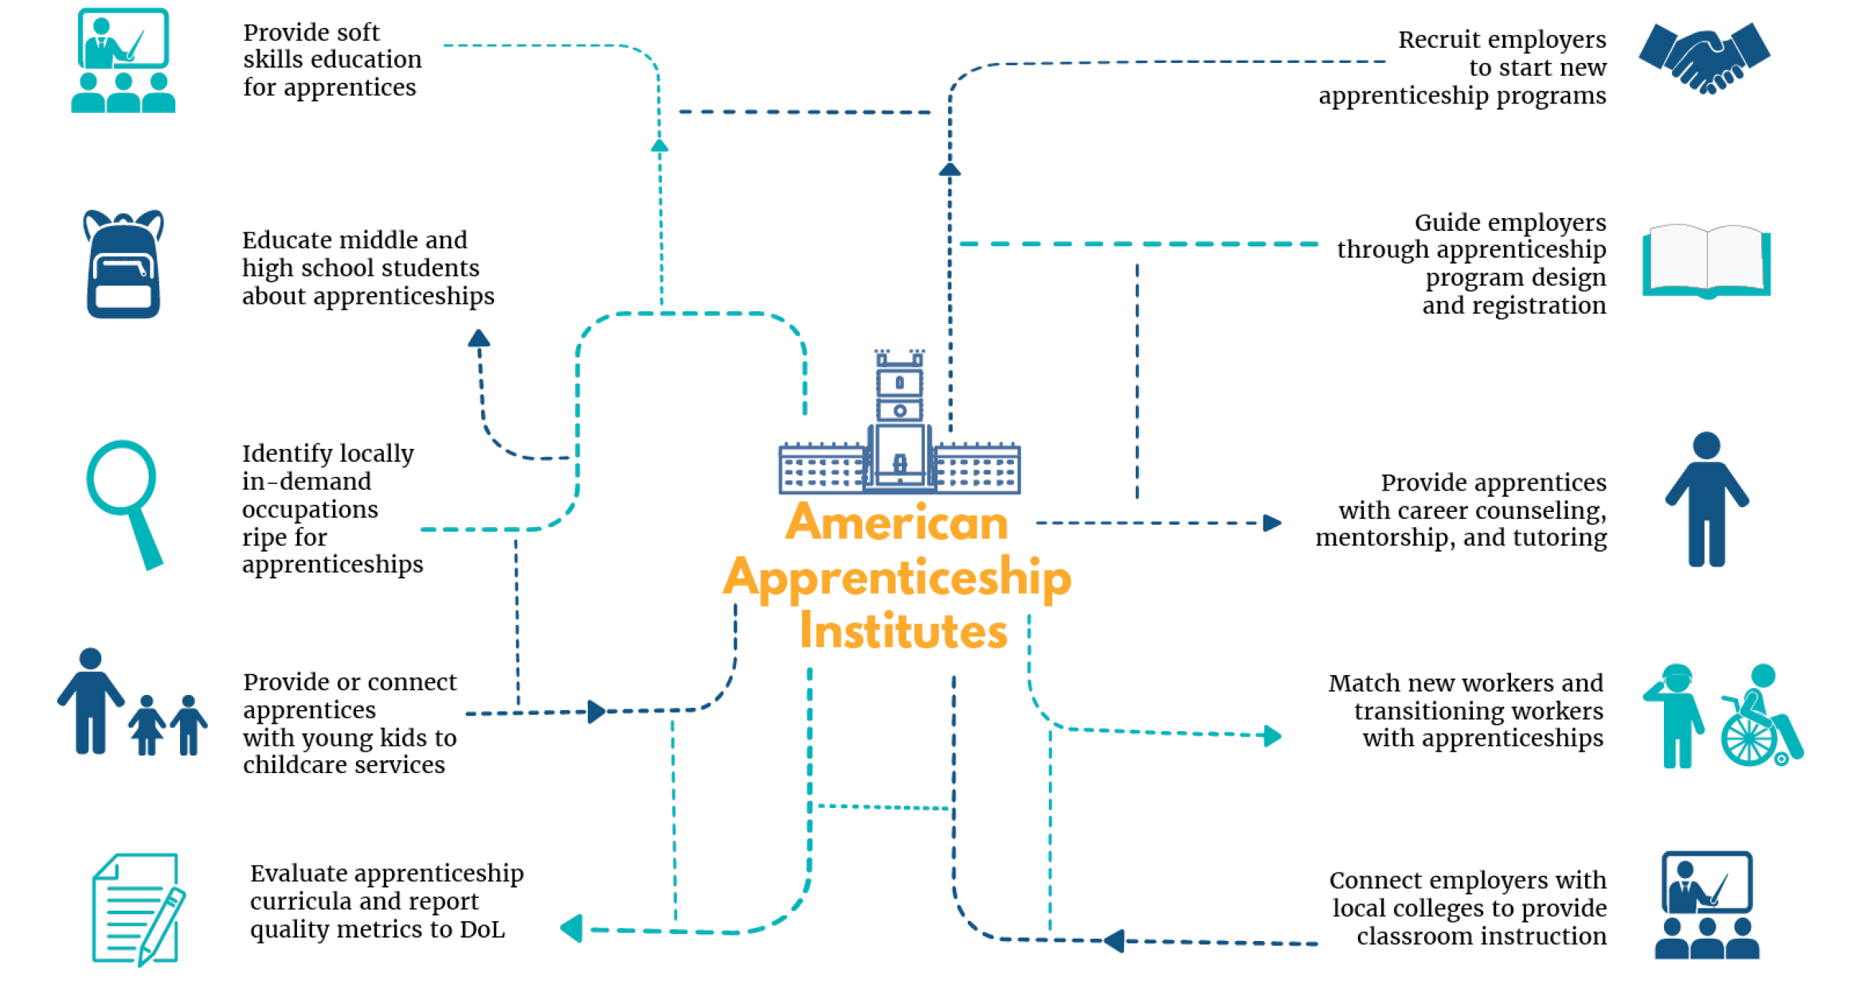
Reimagining What Schools Do
Credit Third Way national think tank

Slide 18
The Old Way:
2000 Hours of On-the-Job Training per year
144 Hours of RSI administratively over seen by local education agencies

Slide 19
NEW WAY FOR APPRENTICESHIP TO MATTER
1
2
3
4
Principle 1.
Apprenticeship is student-centered & industry-led.
Principle 2.
Industry invests in the program and the individual apprentices by providing meaningful paid work-based learning.
Principle 3.
Apprenticeship is not an “alternative” to higher education, but leverages and integrates higher education for the greatest impact.
Principle 4.
Apprenticeships multiply options for those seeking access to high paying careers.

Slide 20
NEW LOOK FOR PROGRAMS – FALL 2020

Slide 21
The Old Tricks:
Large Program Sponsors
Aggregated linear occupations
Allocated RSI hours and SAM Code A

Slide 22
THE MISSING SPONSORS…
RCCD is the Local Education Agency “LEA”
40+ Employers hosting apprentices
350+ Apprentices in training
2000+ Incumbent Journeypersons Supervising
IBEW “Sponsor”

Slide 23
TRAINING & ADMINISTRATIVE CAPACITY
Maintain training facilities accessible to communities
Recruit and prepare apprentice candidates
Hire instructors, schedule and run classes, and manage enrollment
Deal with day-to-day obstacles apprentices and employers run into through participation

Slide 24
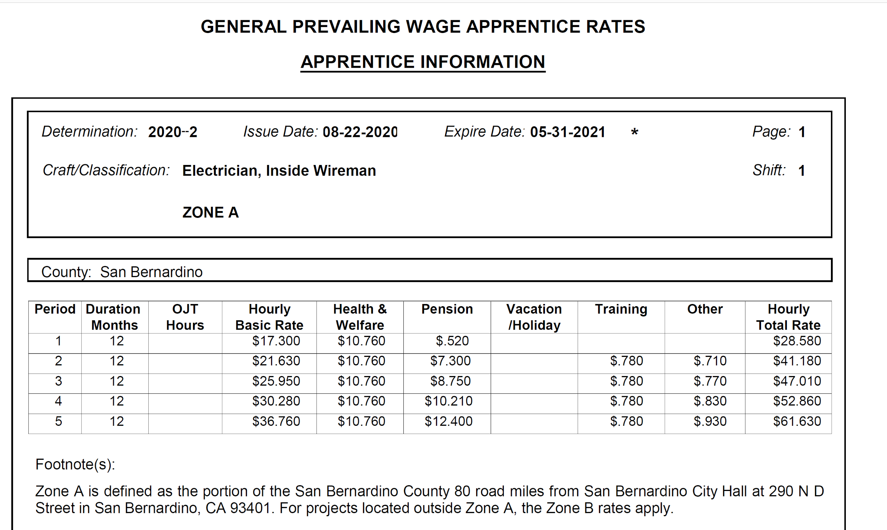
LADDER PROGRAMS
Consistent Job Title
10,000 of Consistent Work- Processes
Advancement is Scheduled
Apprenticeship Follows the Apprentice Even to New Employer

Slide 25
On Paper, It Looks the Same
Program Sponsor
Organization/Entity
Registers standards with Division of Apprenticeship Standards and/or Department of Labor
Operates Apprenticeship program
Completes agreements with education partners
Holds apprentice agreements with individual apprentices
Program Occupation
Apprenticeship Pathway
Identified/specific occupation and general work processes
Outline of On-the-Job training hours and goals
Outline of Related Instruction (course/lab classroom)
Designated start and end points for individual apprentices

Slide 26
LINEAR VS. DYNAMIC
Dynamic Apprenticeship Focuses on the Learning more than the Occupation

Slide 27
TRADITIONAL COLLEGE STUDENT
Consists of a standard track
of courses involving general
education + major classes
Most likely working a job
unrelated to the field of study
Graduate
(Certificate or Degree)
Hopefully find job
Start at lower wage and jump to next company for more money
Take time to figure out how to fit into industry / company culture
VERSUS . . . APPRENTICESHIP LIFE
Graduate
Begin working in industry during early part of program
Enroll in college courses related to daily work tasks
Work in the industry and make
Get promoted / continue schooling

Slide 28
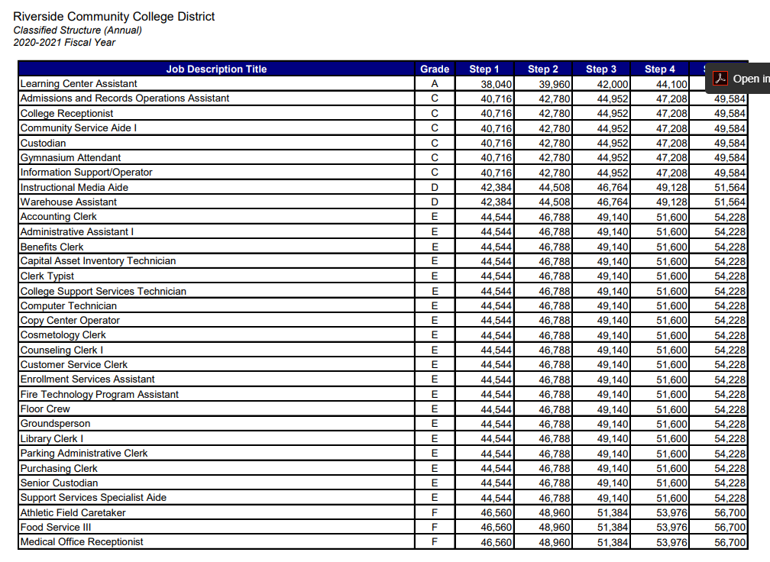
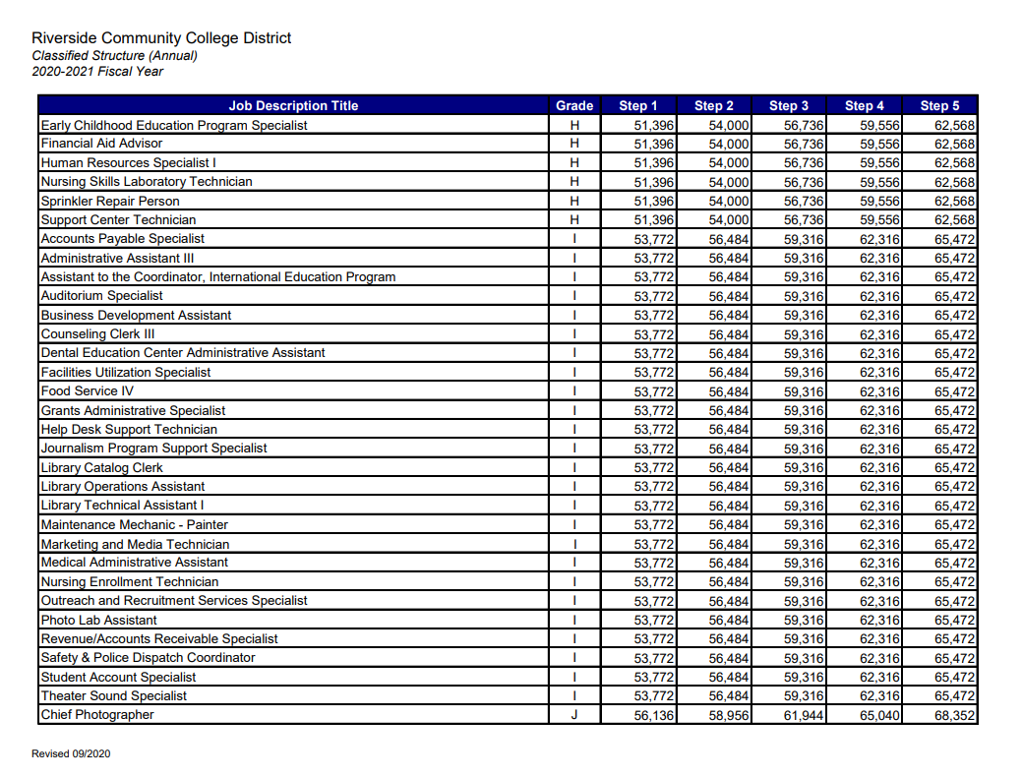
LATTICE PROGRAMS
Multiple Job Titles to Achieve Median Household Income
Diverse Work-processes
Advancement is Dynamic
Can the Apprenticeship Follow the Apprentice?

Slide 29
BUSINESS-TO-BUSINESS-TO-BUSINESS-TO-BUSINESS-TO-BUSINESS-TO-BUSINESS-TO-BUSINESS…

Slide 30
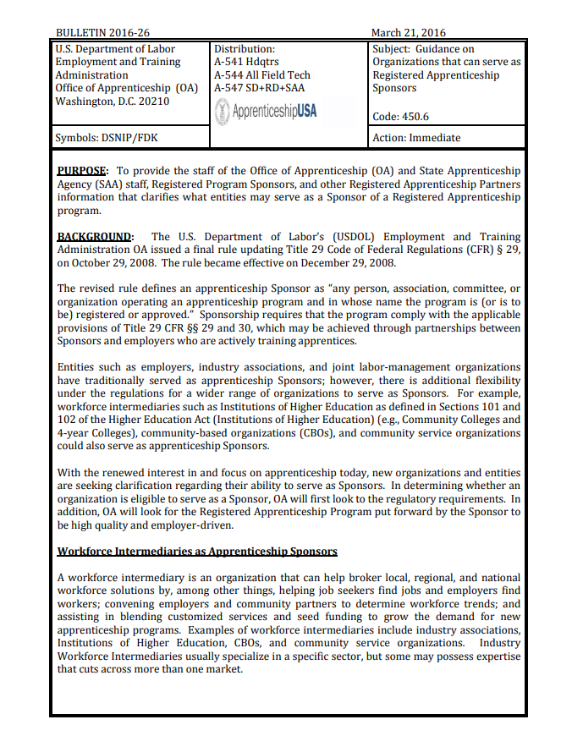
BULLETIN 2016-26
Department of Labor introduced new models of program sponsorship
Higher Education begins sponsoring apprenticeship programs

Slide 31
Labor Code 3074: The preparation of trade analyses and development of curriculum for instruction, and the administration and supervision of related and supplemental instruction for apprentices, coordination of instruction with job experiences, and the selection and training of teachers and coordinators for this instruction shall be the responsibility of, and shall be provided by, state and local boards responsible for vocational education upon agreement with the program sponsor.

Slide 32
Colleges are the Backbone

Slide 33
REGIONAL SYSTEMS
Strategy 1. Develop regional apprenticeship committees
Strategy 2. Focus on multi-employer structures that aggregate needs and professional pathways
Strategy 3. Leverage multiple organizations and workforce systems to serve as resources
Strategy 4. Utilize blended-approach of CTE and contract education services
Strategy 5. Assert the apprenticeship model; not the funding mechanism

Slide 34
INTERMEDIARY STRUCTURE
Industry-Led and Apprentice-centered
The schools provide the administrative services to register and operate the apprenticeship program.
Industry partners provide work-based learning experiences for apprentices through employment and targeted upskilling.
The schools provide the related education component.

Slide 35
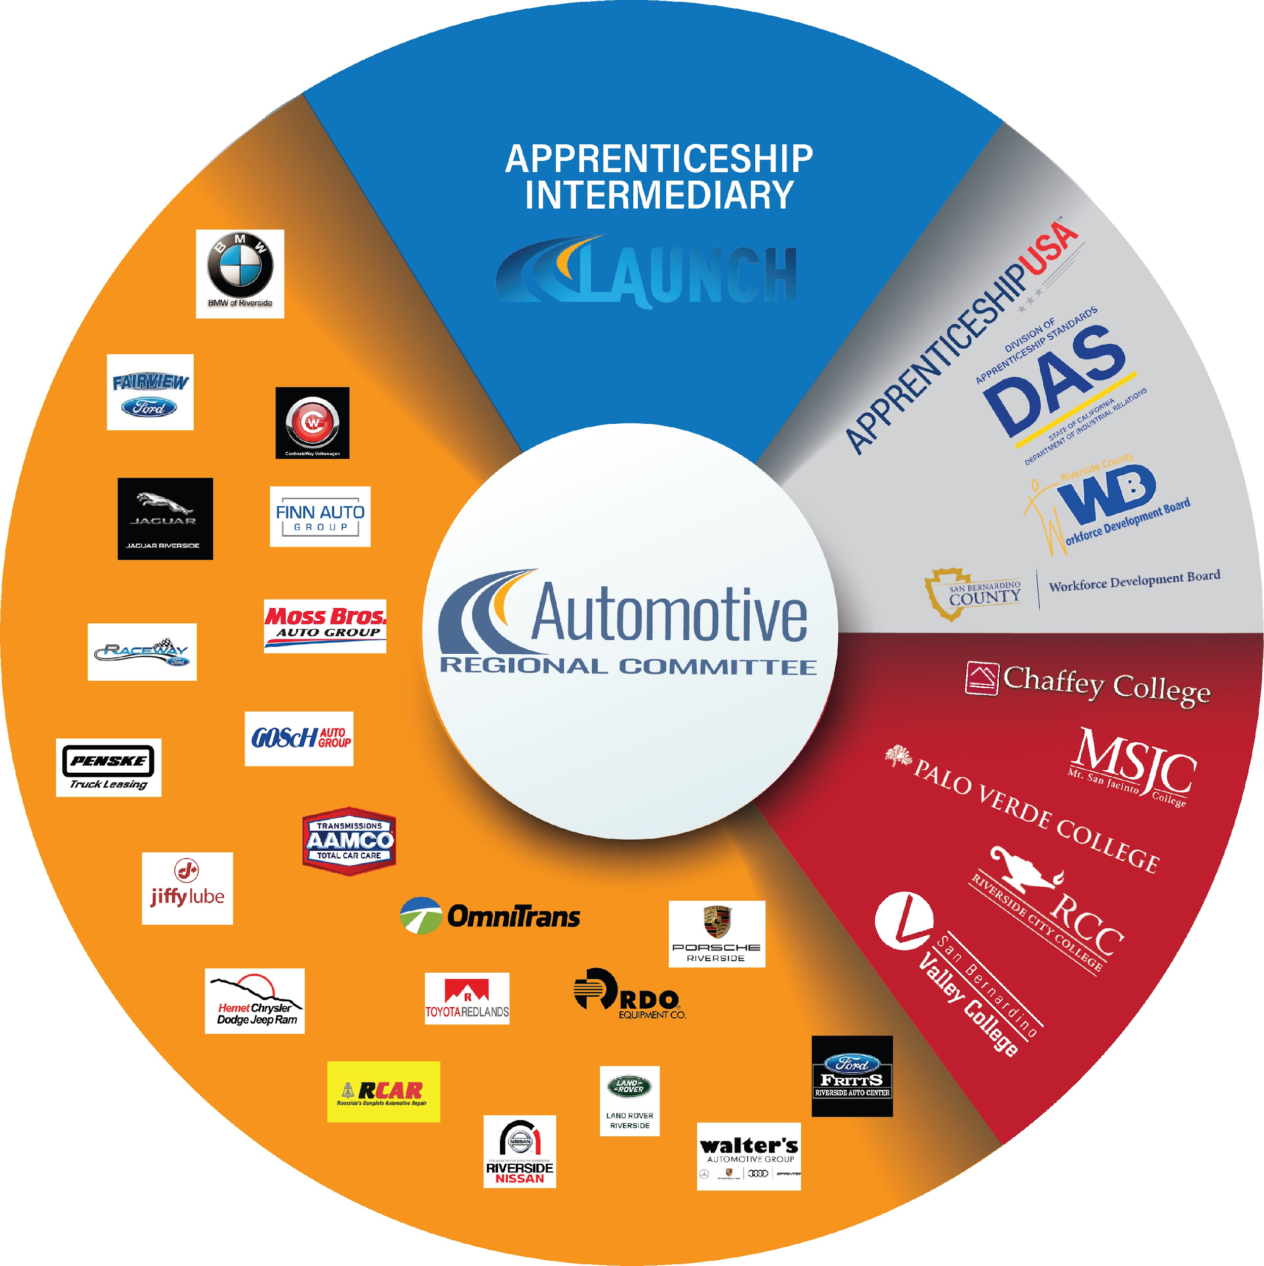
SPONSORSHIP STRUCTURE
Industry-Led and Apprentice-centered
The schools provide the administrative services to register and operate the apprenticeship program.
Industry partners provide work-based learning experiences for apprentices through employment and targeted upskilling.
The schools provide the related education component.

Slide 37
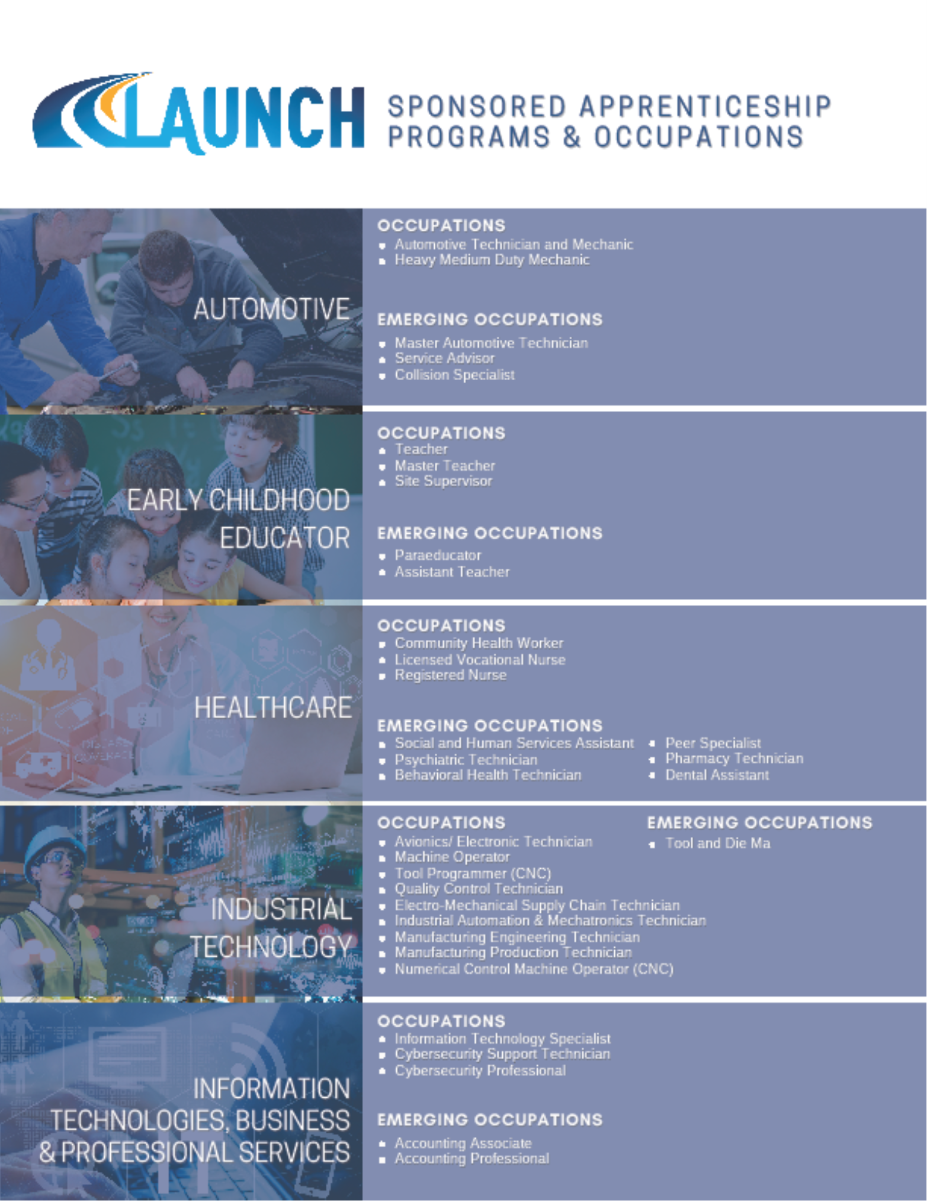

Slide 39
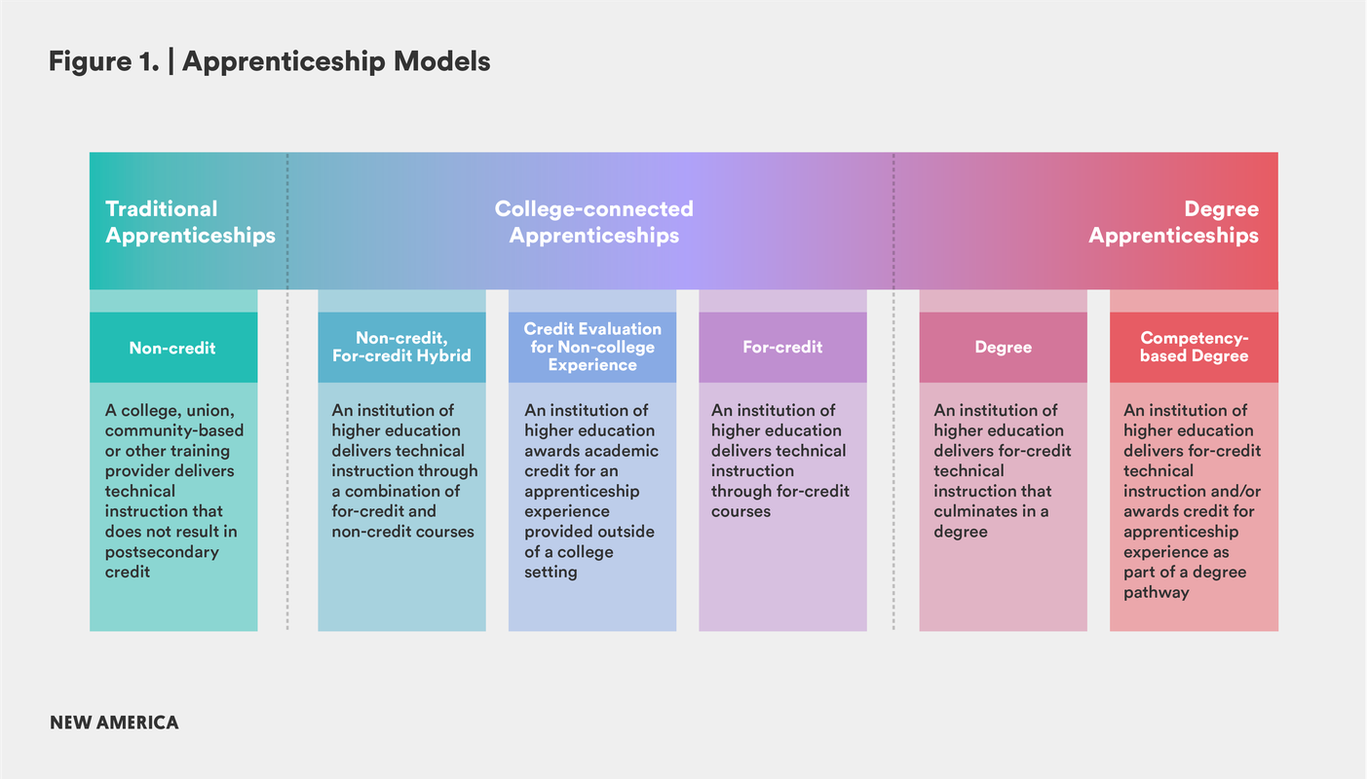
We are Here
We Want to Be Here

Slide 40
DEGREE APPLICABLE WORK-BASED LEARNING UNITS
Student Pathways through apprenticeship
Manufacturing Technician I & II & Degree Track
16 Units of competency-based work experience units
14-16 Units of Related Supplemental Instruction
Best Parts: Experiential learning is the core of the degree
Work-Experience Faculty directly engage workplace learning
What Improvements are Needed: Stronger link between CTE Course units and apprenticeship occupational skills

Slide 41
Leverage the Old Tricks, and Try New Ones
1
2
3
4
Existing Courses & Open Enrollment
-Industry selects courses from college catalogs.
-Confirmed apprentices enroll around their work hours.
Existing Courses & Closed Enrollment
-Industry selects courses and scheduling. Courses are attended exclusively by apprentices.
-Cohort minimums apply.
New Courses & Closed Enrollment
-Industry works with colleges to develop new curriculum.
-If closed enrollment, cohort minimums apply.
Onsite Instructional Delivery
-Classes are run onsite at industry partner’s facility.
-Additional costs and logistics apply.

Slide 42
APPRENTICESHIP INSTRUCTION IN THE CALIFORNIA COMMUNITY COLLEGE SYSTEM
Accreditation Status | Funded by the State’s General Budget | Qualifications of Instructors | Curriculum Development
For-Credit | Yes | Instructors must meet minimum qualifications for apprenticeship instructors (credit) | Curriculum is developed through community college faculty and is approved by state Chancellor’s Office
Non-Credit | Yes | Instructors must meet minimum qualifications for apprenticeship instructors (non-credit) | Curriculum is developed through K-12, COE and community college faculty/instructors and is approved by state Chancellor’s Office
Not-for-Credit & Contract Education | No (AIF-T – 2025) | No standard of minimum qualifications | Curriculum is developed by industry and delivered through contract.

Slide 43
Pedagogy of Apprenticeship
Title | Interaction with Apprentices: | Qualifications Needed: | Selection Process:
Mentors | Mentors are journeyperson, supervisors, professionals, and co-workers that can guide and teach apprentices while on the job. They are employees of the industry partner. | There is no standard qualification, but the mentor must be qualified to speak to the apprentice’s individual skill development. | Industry partners designate mentors for apprentices. This does not limit other supervisors working with/teaching the apprentices.
Work-Based Learning Faculty | These faculty work directly with the apprentice and mentors to verify on-the-job skill progression. Apprentices enroll in a cooperative education course taught by work-based learning faculty. | Instructors must meet minimum qualifications for apprenticeship instructors or work-experience instructors (credit) | For those meeting the cohort minimums, industry partners can designate mentors to enroll as work-based learning faculty. If there is no cohort, the community college will provide work-based learning faculty.
Related Instruction Faculty | These faculty deliver the related technical instruction/curriculum to apprentices in the program. | Instructors must meet minimum qualifications for apprenticeship instructors (credit or noncredit) or applicable education agency or community college minimum qualifications. | Typically, faculty are selected by the community colleges and/or education agency. In some cases, industry may designate faculty to deliver the instruction. This is worked out in supplemental contracts with participating businesses and school districts.
Roles & Responsibilities

Slide 44
WHY IT’S DYNAMIC
CTE Instructors and staff connect students to businesses that introduce students to various skill-building experiences.
Students discover their own unique skills, talents, and interests through experiential learning.
Career Awareness
Career Exploration
Career Training
Career Preparation
Sustained partnerships with, and led by, industry professionals in which students gain competency and develop mastery of professional skills
Employers, industry mentors and educators identify specific professional skills and knowledge relevant to specific industry career paths, and engage students in career planning
Content Credit: State of Michigan: Work-Based Learning Continuum for Secondary State Approved CTE Programs

Slide 45
WHAT’S THE CALL TO ACTION?
We are asking regions to work on apprenticeship collaboratively as colleges and build regional system capacity.
What would this look like:
LARC identifies and develops key leadership for regional apprenticeship initiative.
Establishes regional apprenticeship intermediary sponsorship organizational structure with support from LAUNCH.
We are asking regions to work in partnership with LAUNCH to form multi-regional programs and systems throughout our community colleges.
What would this look like:
LAUNCH program consultancy to colleges building programs within that framework.
Regions share registered apprenticeship pathways through multi-regional apprenticeship committees.

Slide 46
APPRENTICESHIP PROGRAM CONSULTANCY
APCs fulfill the specific needs and objectives outlined in service contracts and grants for which program development is required. Colleges and K-12 partners in LAUNCH need support and assistance in developing new apprenticeship programs, and the APC will work directly with them as a supportive partner during the initial stages of program development and will provide continual services based on the needs of partners. This position will serve as an entry-level professional career pathway for workforce and education professionals developing a career in apprenticeship programs.

Slide 47
QUESTIONS, THOUGHTS & FEEDBACK
Charles Henkels & Natalie Weaver
LAUNCH Apprenticeship Network
Charles@launchapprenticeship.org
Natalie@launchapprenticeship.org

